Slide 1
Logic Circuits
Fătu Samuel

Slide 2
Problem Statement
Exercise 2
Draw the corresponding logic circuit using derived gates, simplify the function and draw the logic circuits associated to all simplified forms of the initial function using only basic gates.
f₈(x, y, z) = x ($\overline{y}$↑ z) ∨ $\overline{x}$ ($\overline{y}$⊕ z) ∨ y (x ⊕ $\overline{z}$)

Slide 3
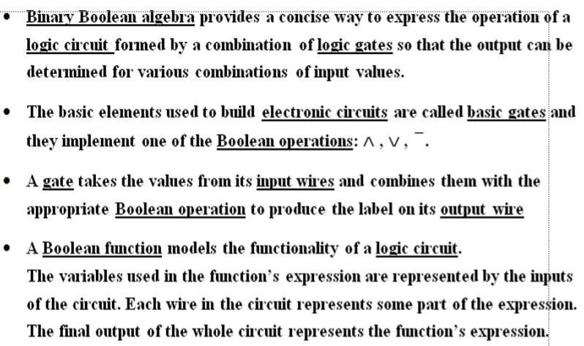
Theory

Slide 4
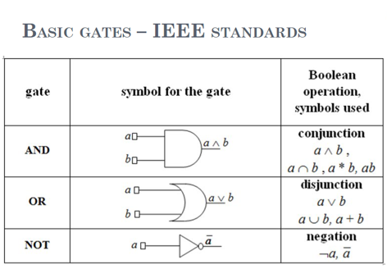
Theory

Slide 5
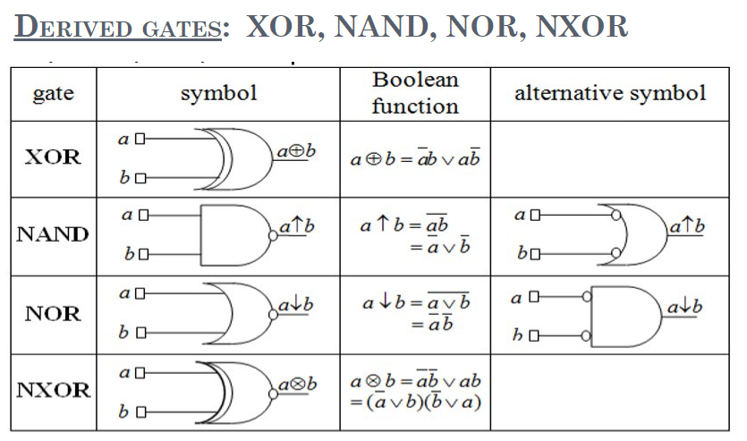
Theory

Slide 6
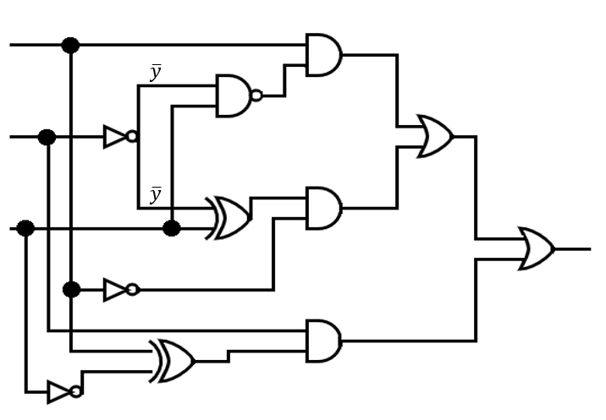





Solution
f₈(x, y, z) = x ($\overline{y}$↑ z) ∨ $\overline{x}$ ($\overline{y}$⊕ z) ∨ y (x ⊕ $\overline{z}$)
x
x($\overline{y}$↑ z)
x ($\overline{y}$↑ z) ∨ $\overline{x}$ ($\overline{y}$⊕ z)
y
$\overline{y}$⊕ z
z
$\overline{x}$ ($\overline{y}$⊕ z)
f₈(x, y, z)
$$\overline{x}$$
y
$$\overline{x}$$
$$\text{x} \text{⊕} \overline{z}$$
y (x ⊕ $\overline{z}$)
$$\overline{z}$$

Slide 7
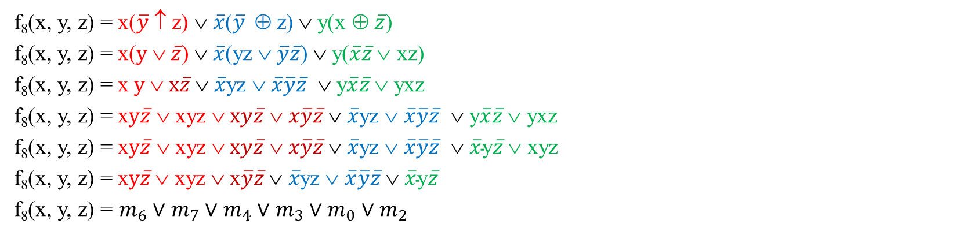
Solution
In order to simplify the function we will use Karnaugh diagram.
We have to write the function into DCF form
f₈(x, y, z) = x($\overline{y}$↑ z) ∨ $\overline{x}$($\overline{y}$⊕ z) ∨ y(x ⊕ $\overline{z}$)
f₈(x, y, z) = x($y \text{∨}$ $\overline{z}$) ∨ $\overline{x}$(yz $\text{}$ $\overline{y}\overline{z}$) ∨ y($\overline{x}\overline{z} \text{∨}$ xz)
f₈(x, y, z) = x $y \text{∨}$ $x\overline{z}$ ∨ $\overline{x}$yz $\text{}$ $\overline{x}\overline{y}\overline{z}$ ∨ y$\overline{x}\overline{z} \text{∨}$ yxz
f₈(x, y, z) = x$y\overline{z} \text{∨} \text{xyz}\text{ ∨}$ $xy\overline{z}$ $\text{} x\overline{y}\overline{z}$∨ $\overline{x}$yz $\text{}$ $\overline{x}\overline{y}\overline{z}$ ∨ y$\overline{x}\overline{z} \text{∨}$ yxz
f₈(x, y, z) = x$y\overline{z} \text{∨} \text{xyz}\text{ ∨}$ $xy\overline{z}$ $\text{} x\overline{y}\overline{z}$∨ $\overline{x}$yz $\text{}$ $\overline{x}\overline{y}\overline{z}$ ∨ $\overline{x}\text{y}\overline{z} \text{∨}$ xyz
f₈(x, y, z) = x$y\overline{z} \text{∨} \text{xyz} \text{∨}$x$\overline{y}\overline{z} \text{∨} \overline{x}$yz $\text{}$ $\overline{x}\overline{y}\overline{z}$ ∨ $\overline{x}\text{y}\overline{z}$
f₈(x, y, z) = $m_{6}$ ∨ $m_{7}$ ∨ $m_{4}$ ∨ $m_{3}$ ∨ $m_{0}$ ∨ $m_{2}$

Slide 8
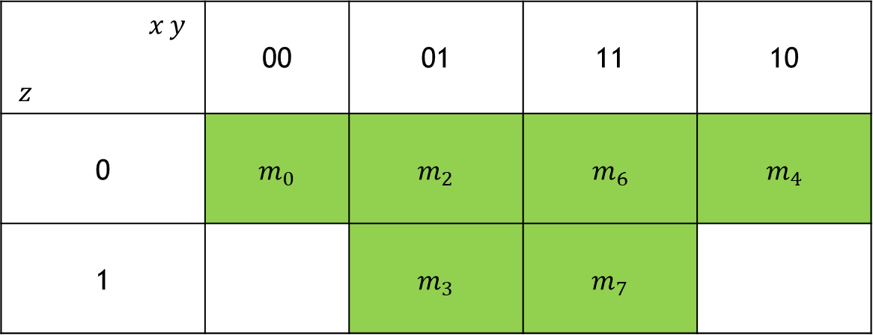
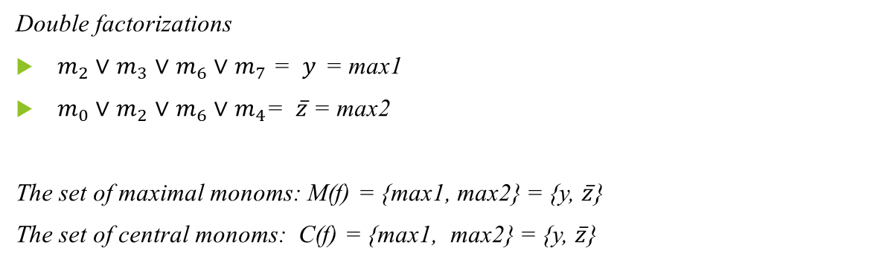
Solution
f₈(x, y, z) = $m_{6}$ ∨ $m_{7}$ ∨ $m_{4}$ ∨ $m_{3}$ ∨ $m_{0}$ ∨ $m_{2}$
${ x}_{ }y_{ }$ $${ z}_{ }$$ | 00 | 01 | 11 | 10
0 | $m_{0}$ | $m_{2}$ | $$m_{6}$$ | $$m_{4}$$
1 |  | $m_{3}$ | $m_{7}$
Double factorizations
$m_{2}$ ∨ $m_{3}$ ∨ $m_{6}$ ∨ $m_{7}$ = $y_{ }$ = max1
$m_{0}$ ∨ $m_{2}$ ∨ $m_{6}$∨ $m_{4}$= $\overline{z}$= max2
The set of maximal monoms: M(f) = {max1, max2} = {y, $\overline{z}$}
The set of central monoms: C(f) = {max1, max2} = {y, $\overline{z}$}

Slide 9
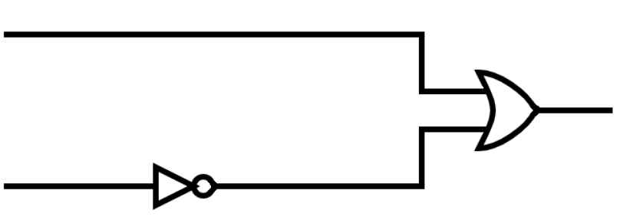


Solution
Because M(f)=C(f) there is a unique simplified form of f, obtained as the disjunction of all central monoms: $f_{ }^{DS}$ = $y_{ } \text{∨}$ $\overline{z}$
$$y_{ }$$
$y_{ } \text{∨}$ $\overline{z}$
$$\overline{z}$$
$$z_{ }$$

